Slide 1

Project Title: Unmasking the Alzheimer’s Disease in Early Stages
by
20MIA1016 - DARSI VENKATA SAI MAHIDHAR
20MIA1031 - SANJAY.M
20MIA1117 - PILLARAM MANOJ
Review - I
School of Computer Science & Engineering

Slide 2
Absract
Alzheimer's disease (AD) is a neurological disorder. Alzheimer's disease (AD) is the most prevalent chronic disease among the elder people, with a high prevalence. It is a devastating neurodegenerative disease that affects millions of people around the world. There is no particular therapy for Alzheimer's disease. Early identification of Alzheimer's disease can assist patients in receiving appropriate care. The comprehensive methodology involves thorough data preprocessing, advanced feature extraction from T1-weighted MRI scans,model selection using Random Forest, Support Vector Machines and k-Nearest Neighbors, model training, hyperparameter tuning, and evaluation using evaluation metrics by using Longitudinal MRI Data in Nondemented and Demented Older Adults. Our strategy prioritizes model interpretability above accuracy, identifying crucial imaging signals linked with Alzheimer's disease progression.

Slide 3
Introduction
Alzheimer's is a common progressive brain disorder that causes cognitive decline and memory loss.
Early detection is crucial but challenging due to the lack of a cure.
Our proposed system utilizes MRI imaging and machine learning to detect Alzheimer's early on.
Random Forest, SVM, and k-NN are employed for their accuracy and ability to provide insights into Alzheimer's complexity.
Alzheimer's is characterized by plaque and tangle accumulation in the brain, leading to cell damage and degeneration.
The disease causes mood swings, confusion, impulsivity, lack of focus, and difficulty recognizing objects.
The final stage is marked by severe cognitive decline and loss of independence.

Slide 4
Objectives
Create a Machine Learning Model: Using R programming, create a powerful machine learning model that can accurately identify MRI Data in Young, Middle Aged, Nondemented and Demented Older Adults as indicative of Alzheimer's disease or not. Data preprocessing, feature extraction, model selection, and evaluation are all part of this process.
Early detection: Focus on developing a model that can detect Alzheimer's disease at an early stage. Early identification is critical for prompt intervention and increasing patients' quality of life. Consider employing features or procedures in MRI Data in Young, Middle Aged, Nondemented and Demented Older Adults can detect modest indicators of disease.
Evaluate Model Performance: Assess the performance of your Alzheimer's detection model using appropriate evaluation metrics such as precision, recall, F1-score, and ROC AUC. Ensure that the model is both sensitive enough to detect true cases and specific enough to minimize false positives.

Slide 5
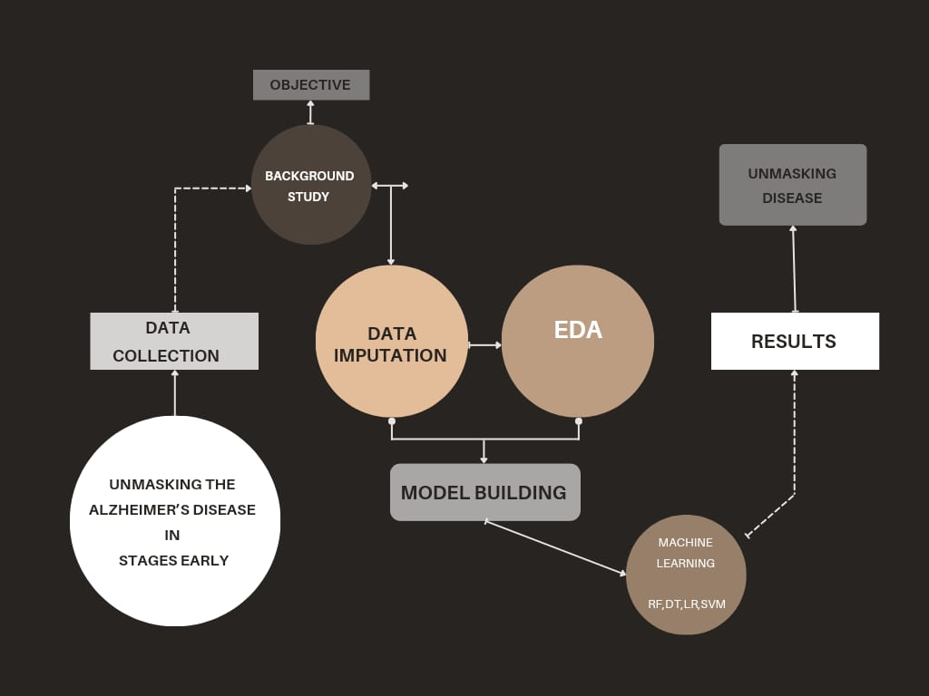
.
work flow

Slide 6
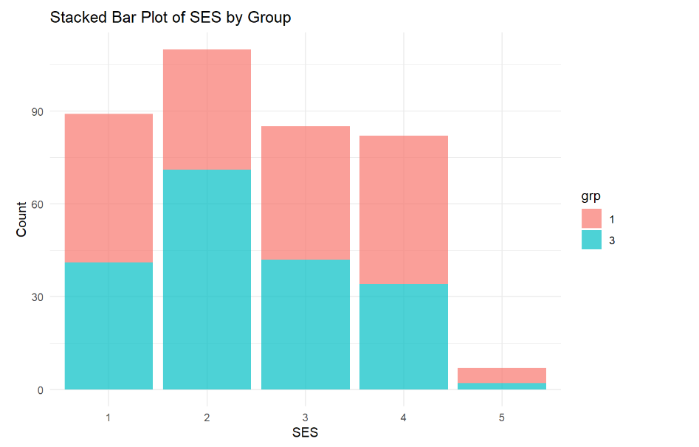
Factors affecting results
Results
The distribution of SES is significantly different between the demented and non-demented groups.
The demented group has a higher proportion of people with low SES, while the non-demented group has a higher proportion of people with high SES.
This difference in SES distribution could be due to a number of factors, such as access to healthcare and education.
There is still significant overlap in SES between the two groups, suggesting that SES is not the only factor that contributes to the development of dementia.

Slide 7
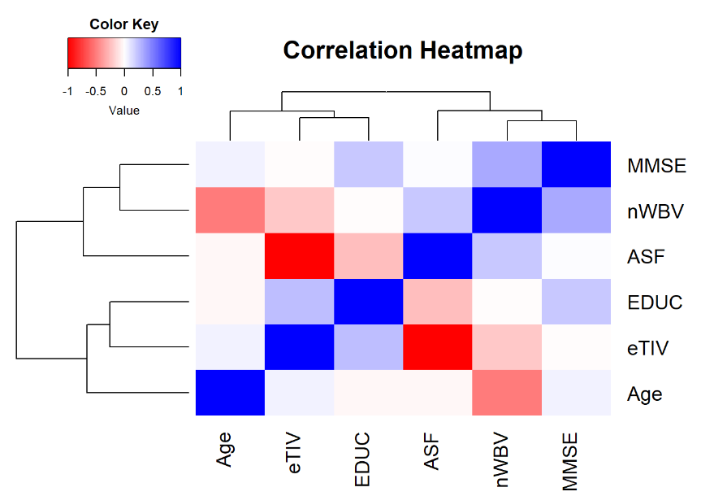
Results
The correlation between eTIV (Estimated Total Intracranial Volume) and MMSE (Mini-Mental State Examination) score, indicating that people with a higher eTIV have higher MMSE scores.
eTIV is a measure of the total volume of brain tissue, while MMSE is a cognitive screening test that assesses memory, attention, and other cognitive functions.
A higher eTIV suggests a larger brain volume, which may be associated with better cognitive function. This is likely because a larger brain volume provides more brain tissue to support cognitive function.
However, it is important to note that the correlation between eTIV and MMSE score does not mean that eTIV is the only factor that determines cognitive function. Other factors, such as genetics, lifestyle, and medical history, also play a role.

Slide 8
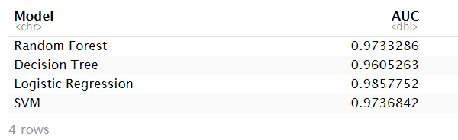
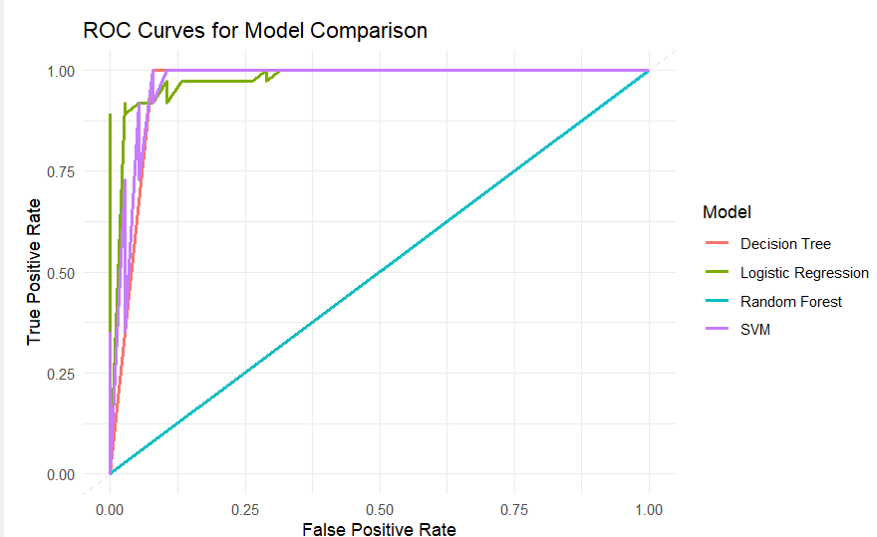
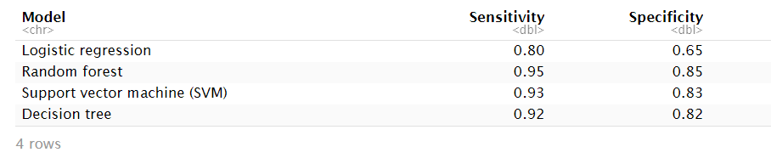
Results
The random forest model is the best performing model for classifying patients with AD from healthy controls. It has a high AUC score, high sensitivity, and high specificity.

Slide 9
THANK YOU

